Slide 1
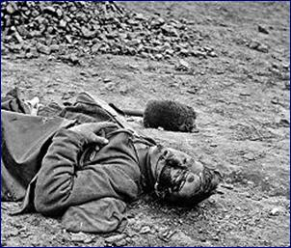
futility
FUTILITY

Slide 2
Move him into the sun -

Slide 3
Gently its touch awoke him once, At home, whispering of fields unsown.

Slide 4
Always it woke him, even in France,

Slide 5
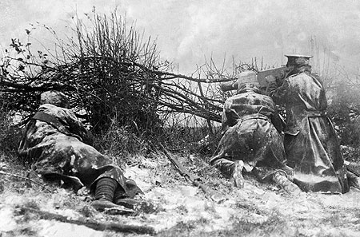
Until this morning and this snow.

Slide 7
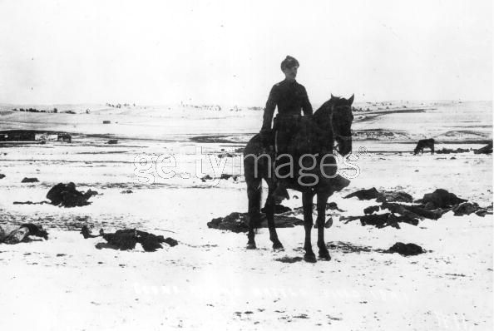

Slide 8
If anything might rouse him now
FUTILITY

Slide 9
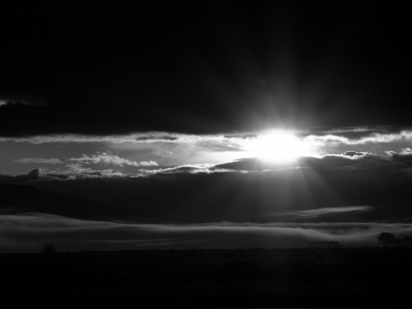
The kind old sun will know.

Slide 10
Think how it wakes the seeds, -

Slide 11
Woke, once, the clays of a cold star.

Slide 12
Are limbs, so dear-achieved, are sides, Full-nerved -still warm -too hard to stir?

Slide 13
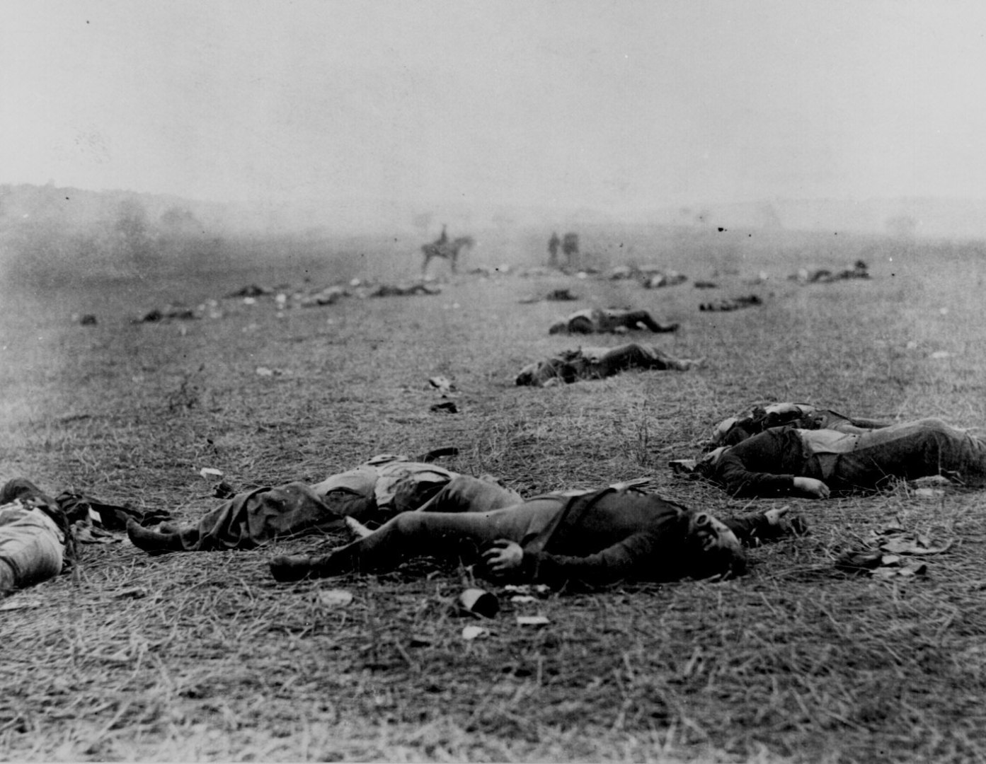
Was it for this the clay grew tall?
Are limbs, so dear-achieved, are sides, Full-nerved -still warm -too hard to stir?

Slide 14
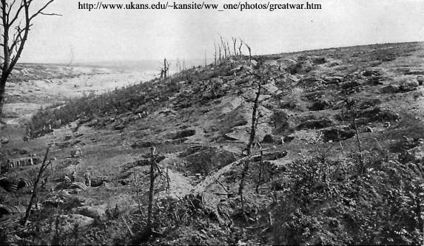
- O what made fatuous sunbeams toil To break earth's sleep at all?

